Slide 1
Privacy and Voice Screening
For Environmental Sound Identification

Slide 2
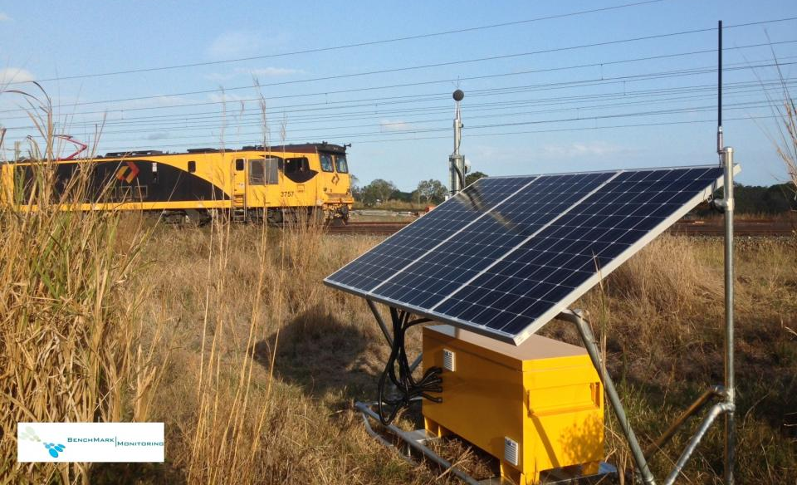
The context: environmental sound identification
For industrial noise management
Notes:
ENvironmental sound identification - using AI/Machine learning to classify audio
Industrial applications: measure noise pollution, track vehicle movement

Slide 3
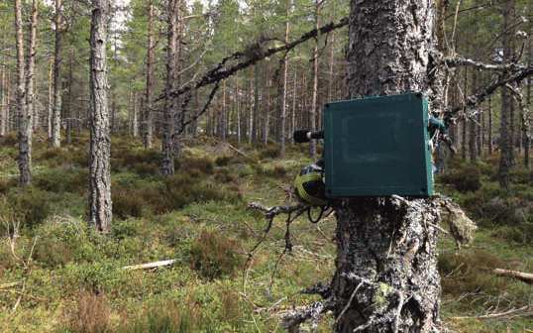
The context: environmental sound identification
For environmental management
Notes:
Environmental applications - survey bird/insect/frog populations, track human or animal movements

Slide 4
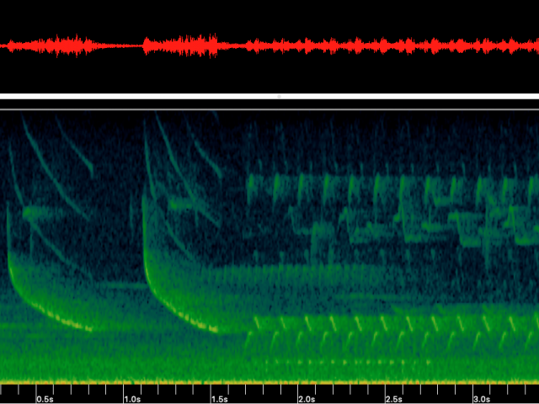
The problem: privacy!
What if it records a voice?
High quality recordings of private conversations, taken without consent
Notes:
Sensors are recording high quality audio data - what happens when someone has a conversation nearby?
The conversation is recorded & stored -> privacy issue

Slide 5
The solution - pre-screening
[sketch diagram]
Notes:
Use a simple ML model immediately after recording
to identify data containing voice and exclude it from further analysis

Slide 6
Why our solution?
Prevents sensitive data from being stored
Data is screened at earliest possible point in the process
Minimal impact to the monitor’s function
Notes:
[see slide]
Importantly, it’s streamlined
By focusing on only whether data is voice or non-voice, much less computation is required than standard voice recognition

Slide 7
Solution details
[detailed flowchart]

Slide 8
Important goals
The rest of the system works just as well
Adaptable inputs
Accurate classification
Traceability
Low resource use
Notes:
Voice identification shouldn’t compromise the system’s function
Ideally work with whatever the system’s input is
Clearly record when data is excluded
Monitors are usually in remote environments - power and network connection comes at a cost
Ensure representative voice identification (vocal range, accent, language)

